Slide 1
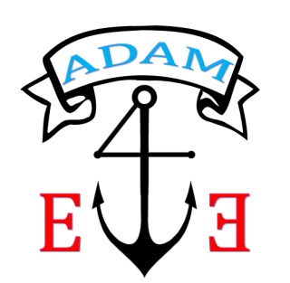
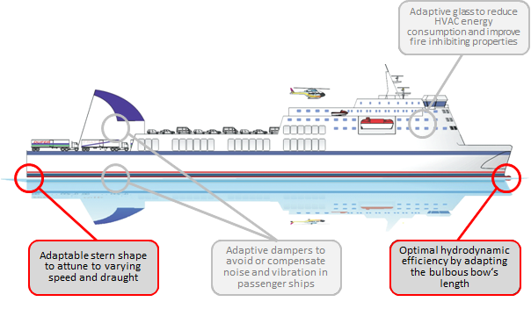
Save the date for the Adaptive ship hull forms workshop
4th of June, 2015
At VTT Technical Research Centre of Finland

Slide 2
About the workshop
Scope:
The project invites you to experience smart materials and structures that are applied to make vessels more adaptable to changing environmental and operational conditions.
The project develops applications for outfitting materials and for ship hull forms. Within the workshop, you will see different applications for adaptive hydrodynamic properties and discuss about the state of the art and future of these new materials and structures.
Schedule:
June 4th, 9 a.m. - ca. 5 p.m.
ADAM4EVE introduction
Overview on ADAM4EVE solutions for outfitting material
Presentations and practical demonstrations:
Adaptable stern flap for RoPax vessels
Adaptive rudder propeller used in ferry vessels
Adaptive bow for inland water way ships
Panel discussion
Refreshments
More information and a detailed agenda will be provided soon.
Organisation:
On behalf of
www.adam4eve-project.eu
Matthias Krause
Center of Maritime Technologies e. V.
Bramfelder Str. 164
22305 Hamburg, Germany
Fon: +49 (0)40 6920876 33
Location:
VTT Technical Research Centre of Finland, Espoo (Otaniemi)
Registration:
The workshop is free of charge.
Please register via e-mail before May 26th, 2015:
krause@cmt-net.org, indicating your name and the name of your organisation.
The ADAM4EVE project is funded in the Seventh Framework Programme of the European Union
Contract No.: SCP2-GA-2012-314206

